Slide 1
E D U N A B I O
BB
BIODIVERSIDAD
AGROBIODIVERSIDAD

Slide 2
Background
DAAD call Biodiversity
Submission of 27 project proposals - Selection of 6 projects
Financial support for 2014 and 2015
Financial support for 2016 and 2017 upon the evaluation of the results of the first two years

Slide 3
Partners- task and expertise UPDATED
Partner UR
University of Rostock
Faculty of Agricultural and Environmental Sciences (PD Dr. Bettina Eichler-Löbermann, Prof. Ralf Uptmoor, Prof. Konrad Miegel)
Faculty of Mathematics and Sciences (Prof. Peter Langer, Prof. Alfred Flint,)
Faculty of Social Sciences and Economy
(Prof. Nikolaus Werz)
Application and project management
e-learning modules, MOOCs
Quality management and evaluation
Internet platform
Expertise:
Cropping systems
Molecular biology and breeding
Soil Science
Environmental factors
Special crops and plant ingredients
Chemistry/Organic chemistry
Didactic
Politics

Slide 4
Partners- task and expertise
Partner UG
Universidad Granma - Bayamo (Cuba)
Faculty of Agriculture
(Prof. Raúl López, Dr. Dilver Pena)
Opening workshop 2014 (together with UCLV)
Knowledge transfer
Expertise:
Cropping systems
Management of natural resources
Biochemistry

Slide 5
Partners- task and expertise
Partner UCLV
Universidad Central de las Villas – Santa Clara (Cuba)
Faculty of Agriculture
(Dr. Andres Castro, Dr. Pedro de Fé)
Faculty of Chemistry and Pharmacy
(Dr. C. Luis Bravo Sánchez)
Institute for Biotechnology
(Dr. Osvaldo Fernández)
Opening workshop 2014 – together with UG
e-learning
Quality management and Evaluation
Expertise:
Cropping systems
Animal Science
Biotechnology
Chemistry and Phamarcy
Naturopathy and medicine plants
Soil science

Slide 6
Partners- task and expertise
Partner ULP
Universidad La Plata (Argentina)
Faculty of Sciences, Department of Ecology
(Prof. Santiago Sarandon)
Faculty of Sciences, Department of Chemistry
(Dr. Jorge Jios)
Environmental education
Knowledge transfer and teacher training
workshop 2017
Expertise:
Management of agro-ecosystems
Integrated plant protection
Indicators for sustainability
Chemistry of natural products

Slide 7
Partners- task and expertise
Partner CB
Corpoica Bogotá (Colombia)
Center of Biotechnology
(Dr. Alba Marina, Dr. Martha Gómez, Laura Villamizar)
Universidad Ciencias Aplicadas
Internet-Platform
Field trip 2015
workshop 2015
Knowledge transfer
Course Microbial Diversity
Expertise:
Biotechnology
Agroforestry
Mixed cropping systems
Microbiology and microbial diversity

Slide 8
Partners- task and expertise
Partner UNA
Universidad Nacional Agraria – Managua (Nicaragua)
Department of Plant Production
(Dr. Carolina Vega)
Field trip 2016
Workshop 2016
Knowledge transfer
E-learning
Expertise:
Biotechnology
Management of natural ressources

Slide 9
Master Study courses involved
S1 Manejo sostenible de los recursos naturales (Universidad Granma)
S2 Ciencias Agropecuarias (Universidad Granma)
S3 Producción de medicamentos de origen natural (UCLV)
S4 Biotechnolgía de las Plantas (UCLV)
S5 Proteccion Vegetal (Universidad La Plata)
S6 Agroecología (Universidad Nacional Agraria)
S7 Agroforestería tropical (Corpoica in cooperation with Universidad de Ciencias Aplicadas y Ambientales
S8 Salud Animal Avazada (UCLV)
Rostock – Produccion de las plantas y medioambiente

Slide 10
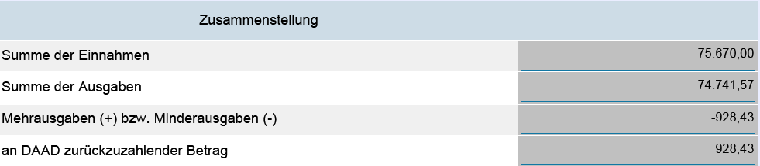
2014 – main outcomes
Finances:

Slide 11
2014 – main outcomes
Finances:
Aministration (Sonia) – 8.942 €
Consumables, small equipment – 5.323
Workshop – 1.500 €
Transport – 22.481 € (48 positions)
Daily allowance – 20.986 € (24 persons)
Indirect expenses – 15.000 €

Slide 12
2014 – main outcomes
Workshop - Cuba March 2014 (Bayamo and S. Clara)
Modules were selected which should be developed regarding aspects of biodiversity.
Each partner nominated one or more responsible persons
Special emphasis was given on e-learning and distant-learning programs.
Another Master course was included into the program: UCLV
Discussion of the academic exchange for 2014
Corpoica offered practical training programs in aspects of “Microbial diversity and Biocontrol”.
The partners agreed to include the field of animal sciences into the project.
The next workshop will be held in Colombia in February 2015.

Slide 13

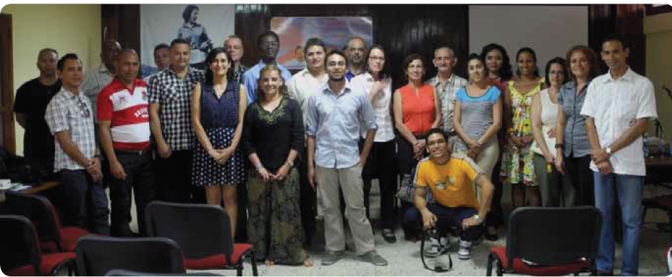
2014 – main outcomes

Slide 14
2014 – main outcomes
Strengthening of cooperation between the institutions
Study and working stays of 24 scientist at 6 different institutions
    2 D – Cu
    1 D - Ar
    4 Co – Cu
    1 Co – Ni
    5 Cu – D
    1 Cu – Ni
    1 Cu – Co
    3 Cu - Ar
    3 Ni – Co
    3 Ni – Cu

Slide 15
2014 – main outcomes
Strengthening of cooperation between the institutions
Further elaboration of the courses/modules regarding biodiversity and environmental issues
Special courses in the field of:
  E-learning/blended learning
  Microbial diversity
  Plant protection and biocontrol
  Agro-ecology
  Chemistry/Synthesis of molecules
Development of demonstration experiments
Literature surveys
Scientific qualification / scientific studies in working groups

Slide 16
2014 – main outcomes
Improvement of the quality in education
Course: e-learning/blended learning UNA
MOOC – Bioenergy and renewable resources – Rostock
Evaluation
Assign the responsible person for each module/course
Questionnaire (responses from three universities)

Slide 17
Evaluation
1. Name of the module?
2. Number of credits
3. How many % of the total time for this module do the students have to be present in lectures or seminars and how many % do they have to work for their own?
4. Practical course or training? How many % of the time of the module are calculated for this practical part?
5. How many and what kind of documents do the students get from the lecturers? In which way (download, copies, ppts, …)
6. Kind of test (for example: written test, 180 min, oral examination 30 min, documentation, …)
7. What is the main difference to classic modules?

Slide 18
2014 – main outcomes
Knowledge transfer
Programs in La Plata and UNA
Projects homepage
www.auf.uni-rostock.de
General description and presentations from the workshop 2014
All are invited to provide relevant documents/information

Slide 19
2015 – tasks and milestones
Report 2014 - Financial issues and projects outcomes – Deadline 28 Feb 2015
Workshop Bogotá and Field trip Villaviciencio
14 Modules need to be reworked/extended regarding aspects of biodiversity
Courses in blended learning
Instruments of evaluation are developed – first pre-tests
Projects homepage – should be located in LA
Knowledge transfer – list of authorities, organizations etc. which are informed about the outcomes of our project
Successful results only possible in close cooperation between all partners
All partners can get profit from the project outcomes

Slide 20
Adventages
Collaboration in education
Distribution of module contents between the partners
English module contents
Evaluation of study courses
Financial support for travels and academic exchange
For senior scientist, PhD students and master students
Research activities and partner institution
Small equipment and services
About 60 000 € per year
Increased visibility of institutions
Official homepage of DAAD
University of Rostock
Third party funds
Notes:
Usually more focus on research

Slide 21
E D U N A B I O
BB
Successfull workshop 2015!
AGROBIODIVERSIDAD

