Slide 1
E D U N A B I O
BB
BIODIVERSIDAD
AGROBIODIVERSIDAD

Slide 2
Background
DAAD call Biodiversity
Selection of 6 projects in Germany
Financial support for 2014 and 2015
Financial support for 2016 and 2017 upon the evaluation of the results of the first two years – confirmed in July 2016

Slide 3
Partners- task and expertise UPDATED
Partner UR
University of Rostock
Faculty of Agricultural and Environmental Sciences (Prof. Bettina Eichler-Löbermann, Prof. Ralf Uptmoor)
Faculty of Mathematics and Sciences (Prof. Peter Langer, Prof. Alfred Flint,)
Faculty of Social Sciences and Economy
(Prof. Nikolaus Werz)
Application and project management
e-learning modules, MOOCs
Quality management and evaluation
Internet platform
Expertise:
Cropping systems
Molecular biology and breeding
Soil Science
Environmental factors
Special crops and plant ingredients
Chemistry/Organic chemistry
Didactic
Politics

Slide 4
Partners- task and expertise
Partner UG
Universidad Granma - Bayamo (Cuba)
Faculty of Agriculture
(Prof. Raúl López, Dr. Dilver Pena, Dr. Guillermo Antunez)
Opening workshop 2014 (together with UCLV)
Knowledge transfer
E-learning
Expertise:
Cropping systems
Management of natural resources
Biochemistry

Slide 5
Partners- task and expertise
Partner UCLV
Universidad Central de las Villas – Santa Clara (Cuba)
Faculty of Agriculture
(Dr. Andres Castro, Dr. Pedro de Fé)
Faculty of Chemistry and Pharmacy
(Dr. C. Luis Bravo Sánchez, Dr. Pedro Iturrias)
Institute for Biotechnology
(Dr. Osvaldo Fernández)
Opening workshop 2014 – together with UG
Quality management and Evaluation
Expertise:
Cropping systems
Animal Science
Biotechnology
Chemistry and Pharmacy
Naturopathy and medicine plants
Soil science

Slide 6
Partners- task and expertise
Partner ULP
Universidad La Plata (Argentina)
Faculty of Sciences, Department of Ecology
(Prof. Santiago Sarandon)
Faculty of Sciences, Department of Chemistry
(Dr. Jorge Jios)
Environmental education
Knowledge transfer and teacher training
workshop 2017
Expertise:
Management of agro-ecosystems
Integrated plant protection
Indicators for sustainability
Chemistry of natural products

Slide 7
Partners- task and expertise
Partner UNA
Universidad Nacional Agraria – Managua (Nicaragua)
Department of Plant Production
(Dr. Carolina Vega)
Field trip 2016
Workshop 2016
Knowledge transfer
E-learning
Expertise:
Biotechnology
Management of natural ressources

Slide 8
Partners- task and expertise
Partner CB
Corpoica Bogotá (Colombia)
Center of Biotechnology
(Dr. Alba Marina, Dr. Martha Gómez, Laura Villamizar)
Universidad Ciencias Aplicadas
(Dr. Edgar Martínez)
Internet-Platform
Field trip 2015
workshop 2015
Knowledge transfer
Course Microbial Diversity
Expertise:
Biotechnology
Agroforestry
Mixed cropping systems
Microbiology and microbial diversity

Slide 9
Master Study courses involved
S1 Manejo sostenible de los recursos naturales (Universidad Granma)
S2 Ciencias Agropecuarias (Universidad Granma)
S3 Producción de medicamentos de origen natural (UCLV)
S4 Biotechnolgía de las Plantas (UCLV)
S5 Proteccion Vegetal (Universidad La Plata)
S6 Agroecología (Universidad Nacional Agraria)
S7 Agroforestería tropical (Corpoica in cooperation with Universidad de Ciencias Aplicadas y Ambientales
S8 Salud Animal Avazada (UCLV)
S9 Agronomía sostenible (UCLV)
Rostock – Produccion de las plantas y medioambiente

Slide 10
2015 – main outcomes
Finances (estimations):
Aministration (Sonia) – 9 000 €
Consumables, small equipment – 5 400 €
Workshop – 1.500 €
Transport – 22 500 €
Excursion - 2 500 €
Daily allowance – 22 000 €
Indirect expenses – 15.000 €

Slide 11
2015 – main outcomes
Workshop/Excursion – Colombia 2015
Each partner nominated one or more responsible persons regarding the modification of the selected Master courses
Another Master course was included into the program: UCLV
Special emphasis was given on e-learning and distant-learning programs (UNA, UDG).
Discussion of the academic exchange for 2015
Overview about agroecology - full text online excess (La Plata)
Presentation the results of the visits of the students from UDG, opportunity of trainings in spectroscopy
Field trip to Villavicencio (“Taluma”, “La Liberdad”)
The next workshop will be held in Managua in February 2016.

Slide 12

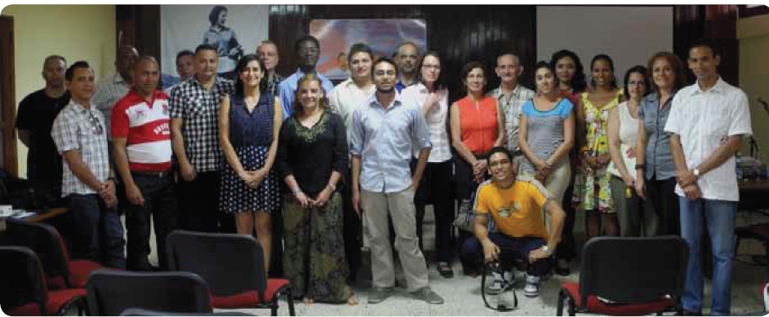

Slide 13
2015 – main outcomes
PR and knowledge transfer
Press release Rostock
Congress of Higher Education Havana Feb. 2016
German Delegation of Higher Education and Academic exchange in Cuba – Feb: 2016
Homepage University of Rostock

Slide 14
2015 – main outcomes
Besuch des Rostocker Rektors an kubanischen Universitäten
Kategorie: Startseite
Seit den 60er Jahren eng mit Kuba verbunden
Vom 18. bis zum 25. Februar reisen Prof. Wolfgang Schareck, Rektor der Universität Rostock, und die Prorektorin für Internationales, Gleichstellung und Vielfaltsmanagement, Prof. Bettina Eichler-Löbermann, nach Kuba. Gemeinsam besuchen sie die Universitäten in Havanna, Santa Clara und Bayamo.
Weitere Reisestationen sind die Universidad Central Martha Abreu de las Villas in Santa Clara, mit der Rostock bereits seit über 55 Jahren zusammen arbeitet, sowie die Universidad de Granma in Bayamo. Beide Universitäten sind gemeinsam mit der Rostocker Alma Mater im DAAD-Projekt Edunabio (Educational Network in Agrobiodiversity) vernetzt, zusammen mit weiteren Hochschulen in Nikaragua, Argentinien und Kolumbien.
Edunabio ist ein Projekt, das im Bereich der Agrar- und Umweltwissenschaftlichen Fakultät angesiedelt ist. Ziel ist es, perspektivisch Aspekte der Agrobiodiversität stärker in der Hochschulbildung in Lateinamerika zu verankern. Geplant ist in diesem Zusammenhang beispielsweise auch, für Studierende Informationen und Modulinhalte als e-learning Angebote über ein Internet-Portal abrufbar zu machen. Zudem erhalten Graduierte und Doktoranden die Möglichkeit, in Arbeitsgruppen der Partnereinrichtungen mitzuarbeiten.

Slide 15
2015 – academic exchange
Strengthening of cooperation between the institutions
Study and working stays of 25 scientist at 6 different institutions
Countries | Numbers
D – Co/Cu | 2
D - Ar | 3
Cu - Co | 7
Cu - D | 4
Co - D | 1
Co – Ni | 2
Ni – D | 2
Ar - Co | 3
Ar - D | 1

Slide 16
2015 – main outcomes
Strengthening of cooperation between the institutions
Further elaboration of the courses/modules regarding biodiversity and environmental issues
Special courses in the field of:
  E-learning/blended learning
  Microbial diversity
  Plant protection and biocontrol
  Agro-ecology
  Chemistry/Synthesis of molecules
Development of demonstration experiments
Literature surveys
Scientific qualification / scientific studies in working groups

Slide 17
2015 – main outcomes
Improvement of the quality in education
Course: e-learning/blended learning UNA
MOOC – Bioenergy and renewable resources – Rostock (2014)
Evaluation
Assign the responsible person for each module/course
Questionnaire and online evaluation (Alfred Flint)

Slide 18
2016 – tasks and milestones
Report 2015 - Financial issues and projects outcomes – Deadline 28 Feb 2016
Workshop Managua Part I and II, Field trip Nicaragua
Modules need to be further reworked/extended regarding aspects of biodiversity
Courses in blended learning/e-learning (Feb 2016)
Evaluation and quality management
Project`s homepage – should be located in LA, social networks
Knowledge transfer – list of authorities, organizations etc. which are informed about the outcomes of our project
Successful results only possible in close cooperation between all partners
All partners can get profit from the project outcomes

Slide 19
Adventages
Collaboration in education
Distribution of module contents between the partners
English module contents
Evaluation of study courses
Financial support for travels and academic exchange
For senior scientist, PhD students and master students
Research activities and partner institution
Small equipment and services
About 60 000 € per year
Increased visibility of institutions
Official homepage of DAAD
University of Rostock…..
Third party funds
Notes:
Usually more focus on research

Slide 20
E D U N A B I O
BB
Successfull workshop 2016!
AGROBIODIVERSIDAD

