Slide 1
E D U N A B I O
BB
BIODIVERSIDAD
AGROBIODIVERSIDAD

Slide 2
Background
DAAD call Biodiversity
Selection of 6 projects in Germany
Financial support for 2014 and 2015
Financial support for 2016 and 2017 upon the evaluation of the results of the first two years – confirmed in July 2016

Slide 3
Partners- task and expertise UPDATED
Partner UR
University of Rostock
Faculty of Agricultural and Environmental Sciences (Prof. Bettina Eichler-Löbermann, Prof. Ralf Uptmoor)
Faculty of Mathematics and Sciences (Prof. Peter Langer, Prof. Alfred Flint,)
Faculty of Social Sciences and Economy
(Prof. Nikolaus Werz)
Application and project management
Reporting
e-learning modules, MOOCs
Quality management and evaluation
Internet platform
Information material

Slide 4
Partners- task and expertise
Partner UG
Universidad Granma - Bayamo (Cuba)
Faculty of Agriculture
(Prof. Raúl López, Dr. Dilver Pena, Dr. Guillermo Antunez)
Opening workshop 2014 (together with UCLV)
Knowledge transfer
E-learning
Description of modules
Materials of scientific practices

Slide 5
Partners- task and expertise
Partner UCLV
Universidad Central de las Villas – Santa Clara (Cuba)
Faculty of Agriculture
(Dr. Andres Castro, Dr. Pedro de Fé)
Faculty of Chemistry and Pharmacy
(Dr. C. Luis Bravo Sánchez, Dr. Pedro Iturrias)
Institute for Biotechnology
(Dr. Osvaldo Fernández)
Opening workshop 2014 – together with UG
Quality management and Evaluation
Final project web page

Slide 6
Partners- task and expertise
Partner ULP
Universidad La Plata (Argentina)
Faculty of Sciences, Department of Ecology
(Prof. Santiago Sarandon)
Faculty of Sciences, Department of Chemistry
(Dr. Jorge Jios)
Environmental education
Knowledge transfer and teacher training
workshop 2017

Slide 7
Partners- task and expertise
Partner UNA
Universidad Nacional Agraria – Managua (Nicaragua)
Department of Plant Production
(Dr. Carolina Vega)
Field trip 2016
Workshop 2016
Knowledge transfer
E-learning

Slide 8
Partners- task and expertise
Partner CB
Corpoica Bogotá (Colombia)
Center of Biotechnology
(Dr. Alba Marina, Dr. Martha Gómez, Laura Villamizar)
Universidad Ciencias Aplicadas
(Dr. Edgar Martínez, Dr. Iván Cruz)
Field trip 2015
workshop 2015
Knowledge transfer
Course Microbial Diversity*
Teaching materials available?

Slide 9
Master Study courses involved
S1 Manejo sostenible de los recursos naturales (Universidad Granma)
S2 Ciencias Agropecuarias (Universidad Granma)
S3 Producción de medicamentos de origen natural (UCLV)
S4 Biotechnolgía de las Plantas (UCLV)
S5 Proteccion Vegetal (Universidad La Plata)
S6 Agroecología (Universidad Nacional Agraria)
S7 Agroforestería tropical (Corpoica in cooperation with Universidad de Ciencias Aplicadas y Ambientales
S8 Salud Animal Avazada (UCLV)
S9 Agronomía sostenible (UCLV)
Rostock – Produccion de las plantas y medioambiente

Slide 10
2016 – main outcomes
Finances (estimations):
Aministration (Sonia) – 9 500 €
Consumables, small equipment – 2 400 €
Workshop – 1.500 €
Transport – 26 500 €
Daily allowance – 22 000 €
Indirect expenses – 15.000 €

Slide 11
2016 – main outcomes
PR and knowledge transfer
Press release Rostock
Congress of Higher Education Havana Feb. 2016
German Delegation of Higher Education and Academic exchange in Cuba – Feb: 2016
HRK meeting Germany
DAAD conference in Bremen
Alumni workshop Berlin

Slide 12
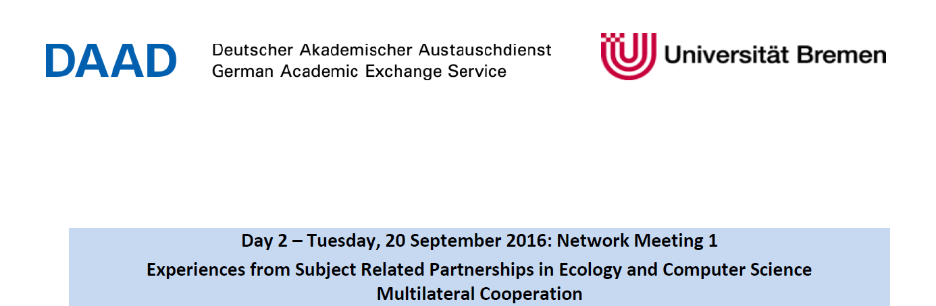
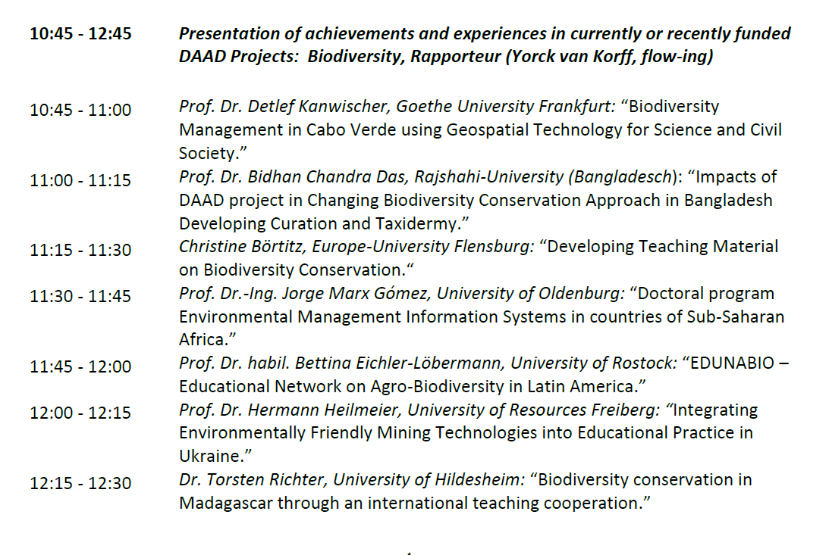

Slide 13
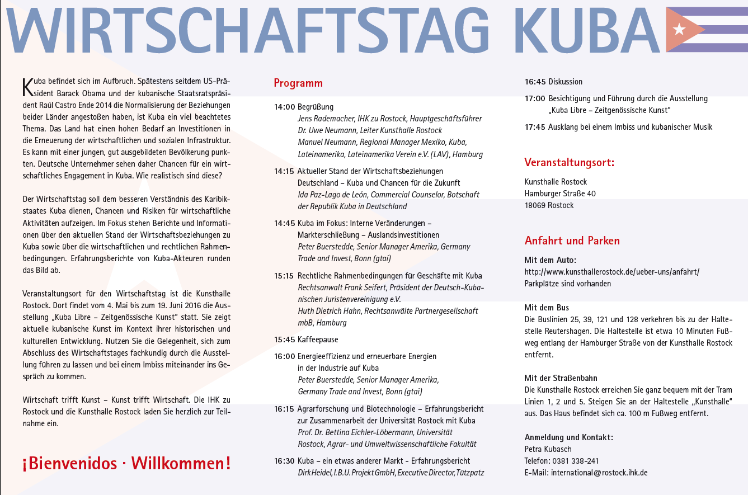

Slide 14
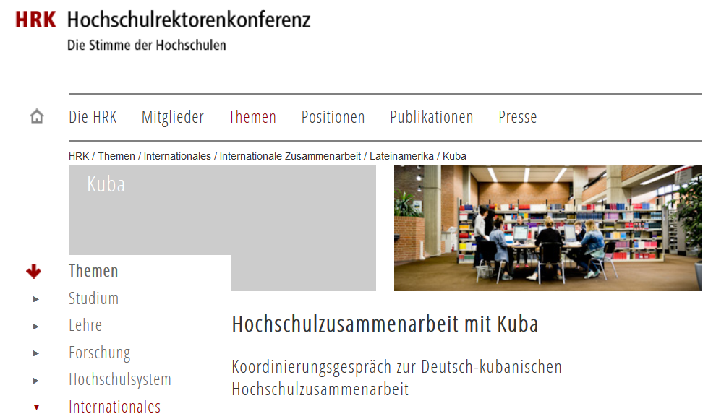

Slide 15
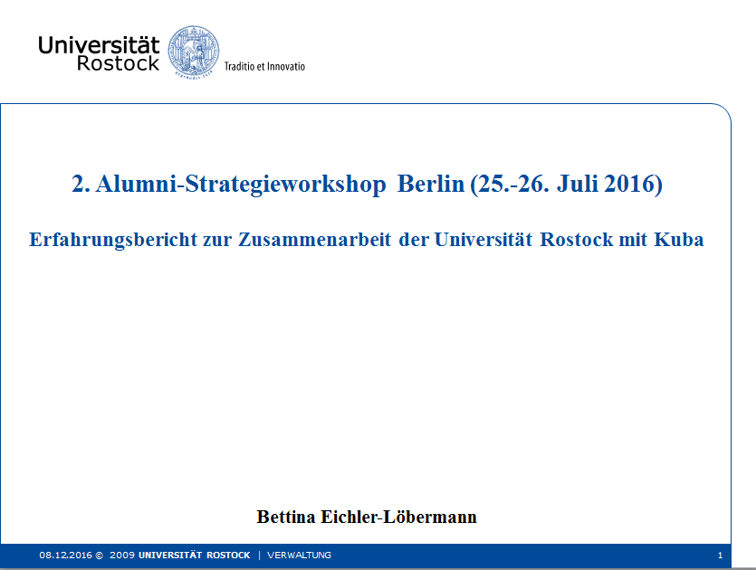
Kuba-Alumni-Strategieworkshop am 25./26. Juli an der Humboldt-Universität

Slide 16
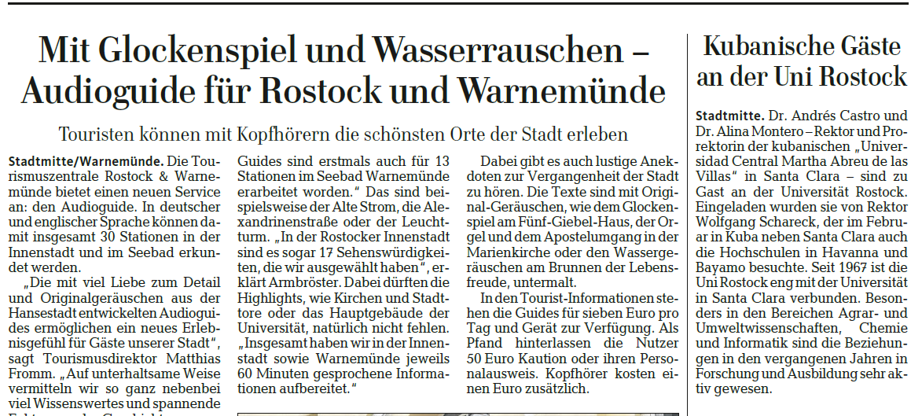

Slide 17
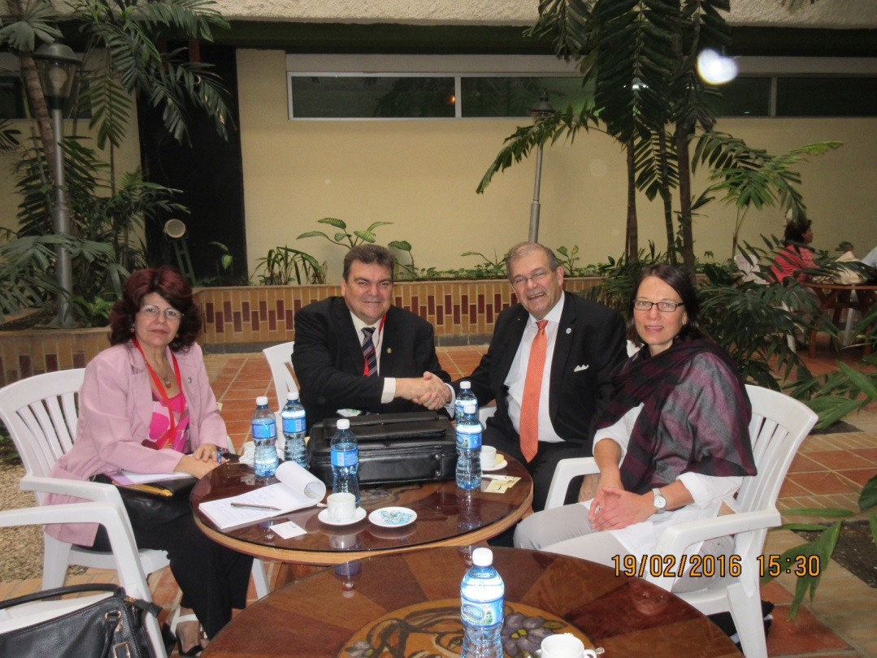
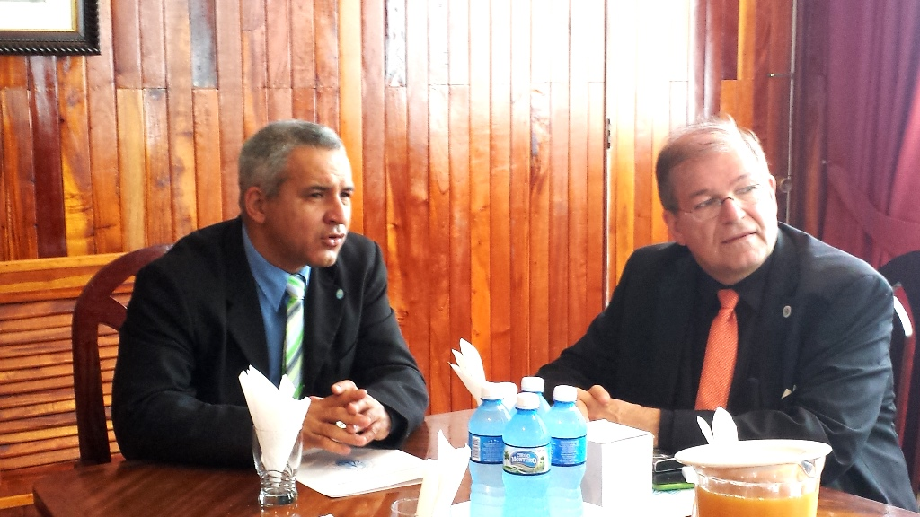
Besuch des Rektors Prof. Schareck
in Kuba 2016
10mo Congreso Internacional de Educación Superior “Universidad 2016”
Implementation of Diversity Management as Part of the Strategic Management at Rostock University

Slide 18
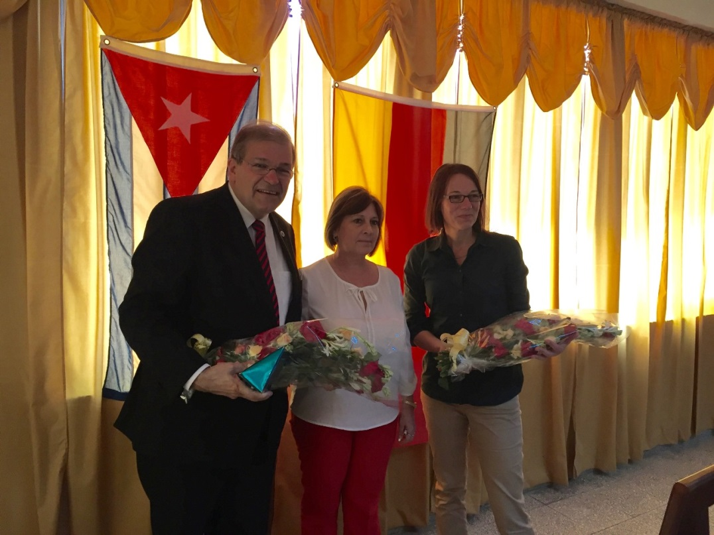
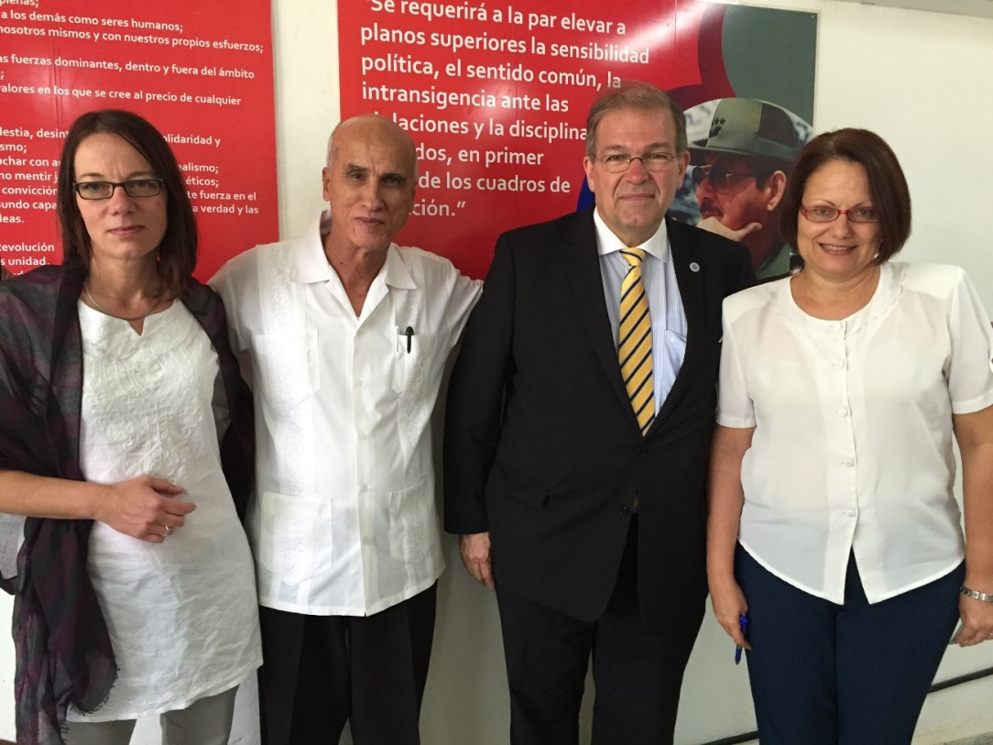
Besuch des Rektors Prof. Schareck
in Kuba 2016
Bayamo Camagüey

Slide 19
2016 – academic exchange
Strengthening of cooperation between the institutions
Study and working stays of 24 scientist at 6 different institutions
Countries | Numbers
D – Cu | 1
D - Ni | 3
Cu - Ni | 6
Cu - D | 6
Cu - Ar | 1
Co - Ni | 3
Ar - Ni | 2
Ar - Cu | 2

Slide 20
2016 – main outcomes
Strengthening of cooperation between the institutions
Visit of the rector of the University of Rostock in Cuba
Further elaboration of the courses/modules regarding biodiversity
Special courses in the field of:
  E-learning/blended learning
  Chemistry/Synthesis of molecules
Compilation of information material on biodiversity
Scientific qualification / scientific studies in working groups
Questionnaire and online evaluation (Alfred Flint)

Slide 21
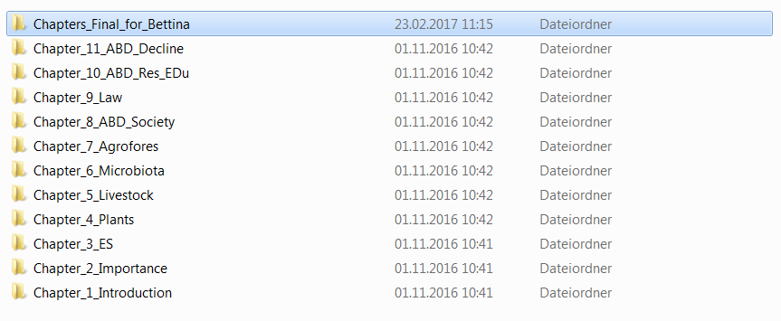
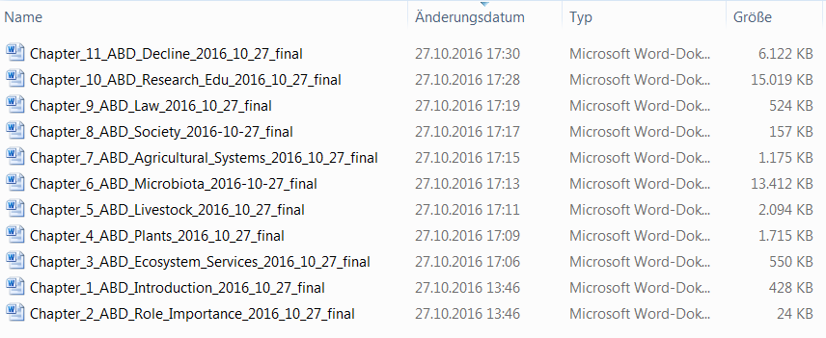
2016 – teaching material

Slide 22
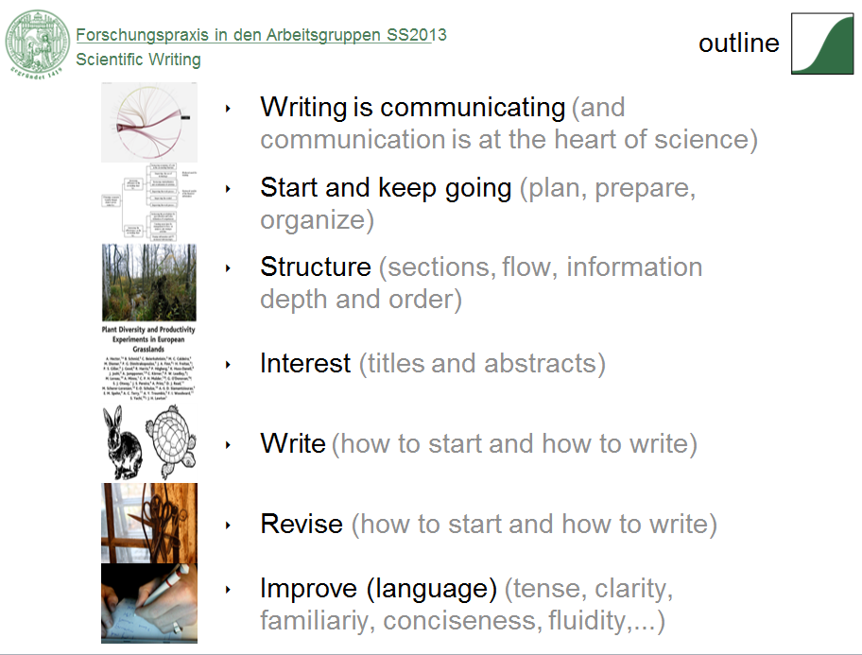
2016 – teaching material
How to write a paper, 120 pages

Slide 23
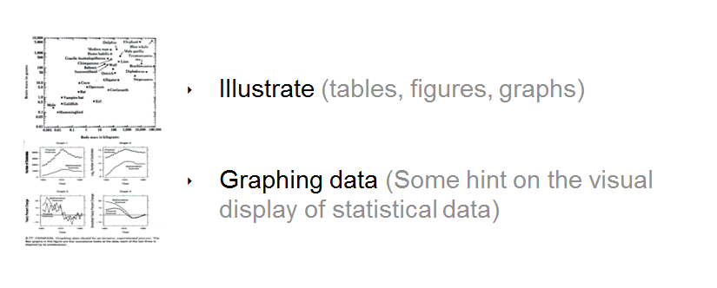
2016 – teaching material
How to write a paper, 120 pages

Slide 24
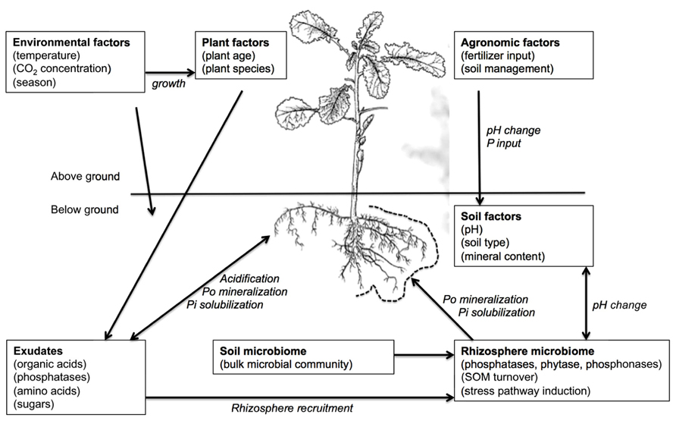
2016 – teaching material
phosphatases

Slide 25
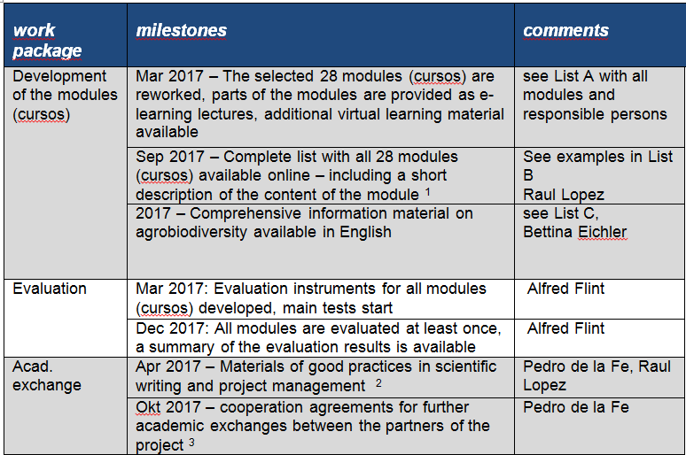
2017 – tasks and milestones
discussion

Slide 26
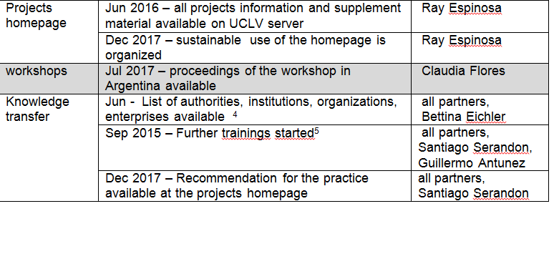
2017 – tasks and milestones
!!!

Slide 27
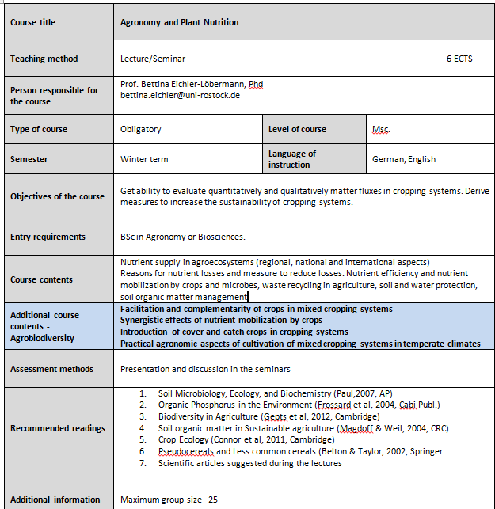
2017 – tasks
and milestones

Slide 28
2017 – new project application
BMBF – Mobility and development of joint cooperation projects in Cuba
Deadline: 30. April (including LoI, signatures etc.)
DAAD – Subject related partnerships with developing countries
Deadline: 30. June (including LoI, signatures etc.)

Slide 29
BMBF: Nutrients in Agriculture and Environment
Interdisciplinary research project
Nutrient recycling
Waste water treatment
Aerobic and anaerobic treatments
Pyrolysis
Crop science
Water management
Waste management
Technology
Nutrient efficiency
Plants
Animals
Microbes
Crop and Soil science
Animal husbandry
Biotechnology
Environmental Management
Modelling of
Nutrient fluxes??
Biology
Geography
University of Rostock, University of Santa Clara, University of Bayamo, University of Havana, University of Pinar del Rio

Slide 30
2017 – new project application
DAAD – Subject related partnerships with developing countries
Vertical Education
Citizen Sciences and Third Missions of Universities
Learn by doing with locals in the fields (LDLF)

Slide 31
E D U N A B I O
BB
Successfull workshop 2017!
AGROBIODIVERSIDAD

